Slide 1
Lesson 6
The Use Case Approach To Software Requirements:
Unity At The Basis Of Diversity
Notes:
ID Course Overview
1 april 04 kl
* deleted redundant uc drives overall development slide
* added quote to use case relationships slide

Slide 2
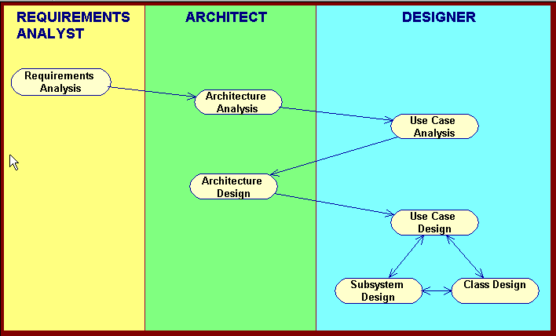
Basic RUP OOAD Activities

Slide 3
Module Main Points
Theme: Use cases are a widely adopted approach to capturing functional system requirements. Use cases are the integrating view in the RUP 4+1 model of system architecture, and drive the development process throughout the entire lifecycle.
1. The main elements of a modern Software Requirements Specification:
- use case models,
- supplementary specifications,
- glossary.
2. A use case is a sequence of actions performed by an actor interacting with the system to achieve a goal, showing how the goal might succeed or fail to be reached
3. Use cases are described in terms of flows and scenarios. A scenario is a single path through a use case. A flow is a set of scenarios that result in the same sort of outcome (e.g., success vs failure flows).
Notes:
ID Course Overview
In this module, we describe recommended software development practices and give the reasons for these recommendations.
The course is divided into modules and each module will begin with a set of objectives to be covered.
In this module, we define the best practices that we believe are fundamental for successful software projects.
We also introduce many terms and concepts that are key in understanding this approach. An extensive glossary is provided in the Rational Unified Process itself.
The highlighted terms are the key terms and concepts introduced in this module.

Slide 4
Requirements Analysis Objectives
Understand the content and purpose of the components of a modern Software Requirements Specification
  Use cases
  Supplementary Specifications
  Requirements Glossary
Understand how use cases are developed, structured, and used
Understand how use cases integrate and drive the entire software lifecycle
Notes:
ID Course Overview
The Requirements Overview module provides an overview of the activities that immediately precede Analysis and Design. It is meant to describe the interface between the Requirements and the Analysis and Design workflows.
The Requirements Overview module will provide enough information so that you will have an appreciation for the Requirements workflow, and will be able to read/interpret the Requirements artifacts that serve as the starting point for the Analysis and Design activities.

Slide 5
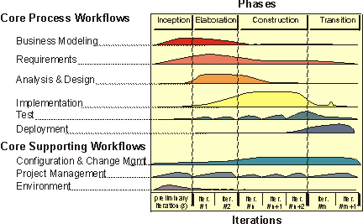
Role of Requirements Analysis in Life Cycle
Inception: identify most use cases, detail critical ones
Elaboration: complete about 80% of use cases
J118

Slide 6
A Modern Software Requirements Specification
Modern SRS Package
User Needs
Problem
Description
Features
Supplementary
Specification
Glossary
Use-case
Model
Software
Requirements
Vision Doc
Design / Test/ Doc
Requirements
Design Model
Test Model
End-user Docs

Slide 7
Better Approach to Requirements
Previous requirements documents often arbitrary collection of paragraphs
  Poor fit with both business reengineering and implementation
State requirements in terms of how end-users use the system
  Easier for end-users to understand and relate to
Notes:
ID Course Overview
- improve situation that requirements documents are often arbitrary collection of paragraphs, having poor fit with both business reengineering and implementation
* state requirements in terms of what user is doing with own job, and hence easier for end users to react to the requirements specs
ALSO COVERED IN LSN 4

Slide 8
Requirements Analysis Topics
A modern software requirements specification (SRS)
Use-Case Model
  Use cases drive entire development lifecycle
  Use case diagrams
  Use case descriptions
  Guidelines for developing use cases
    Business rules in use cases
    Structuring complex use cases
Supplementary Specs
Glossary
Review

Slide 9
What Is a Use Case?
A way in which a user interacts with a system in order to achieve some goal
Goal is often the name of the use case
Example: Withdraw money use case
  Bank Customer identifies himself or herself, and system verifies
  Bank Customer chooses from which account to withdraw money and specifies how much to withdraw, and system deducts the amount from the account and dispenses the money
J42
Notes:
ID Course Overview
NOT NECESSARY, Redundant? -- ok as “review” and lead to next slide

Slide 10
Summary: Use Cases Drive Overall Development
Use cases form the basis of a modern SRS document. Organizing the requirements document around user goals and actions facilitates user understanding of the requirements and the eventual validity of the finished system.
Notes:
ID Course Overview
- improve situation that requirements documents are often arbitrary collection of paragraphs, having poor fit with both business reengineering and implementation
* state requirements in terms of what user is doing with own job, and hence easier for end users to react to the requirements specs
levi:
necessary??

Slide 11
Requirements Analysis Topics
A modern software requirements specification (SRS)
Use-Case Model
  Use cases drive entire development lifecycle
  Use case diagrams
  Use case descriptions
  Guidelines for developing use cases
    Business rules in use cases
    Structuring complex use cases
Supplementary Specs
Glossary
Review

Slide 12
Use-Case Model = Diagrams and Descriptions
The use-case model is composed of use-case diagram(s) and use-case descriptions
Use-Case Model
Actors
Use-Case Model
...
Use-Case Descriptions

Slide 13
Use Case Diagram Basic Components
Initiation
Communication
Actor Icon
Use-Case Icon

Slide 14
Use-Case Modeling: Actors
The use case model starts in the Inception Phase with the identification of actors and principal use-cases.
Actors are not part of the system--they represent anyone or anything that must interact with the system
Actor Icon
Q21

Slide 15

A User May Have Different Roles
The same person might appear as different actors
Does the person use the system in a significantly different manner in the different roles?
Member
Librarian
Mary
Q22, F42-43

Slide 16
Actors are External to the System
System
boundary?
Library System
Member
Catalog

Slide 17
Example: List of Actors and Use-Cases
Actors
  Library Member
  ECardCatalog
  Librarian
Use cases
  Search book
  Check-in books
  Check-out books
  Manage members
Q21

Slide 18
Example: Use-Case Model: Use-Case Diagram
Manage members
librarian
Check-out books
ECardCatalog
Database
Check-in books
library member
Search books

Slide 19
Requirements Analysis Topics
A modern software requirements specification (SRS)
Use-Case Model
  Use cases drive entire development lifecycle
  Use case diagrams
  Use case descriptions
  Guidelines for developing use cases
    Business rules in use cases
    Structuring complex use cases
Supplementary Specs
Glossary
Review

Slide 20
Use Case Descriptions
Name
Brief description
Flows of Events
Relationships
Activity and State
diagrams
Use-Case diagrams
Special requirements
Preconditions
Postconditions
Other diagrams
Use-Case Model
Actors
Use Cases
Use-Case Description

Slide 21
Review: What Are Scenarios ?
A scenario is an instance of a use case
One path

Slide 22
Use-Case Flows of Events
A use case “flow” is a collection of scenarios that have a common structure
A use case has one normal, basic flow
and possibly several other alternative flows to handle:
  Regular variants
  Odd cases
  Exceptional flows handle error situations

Slide 23
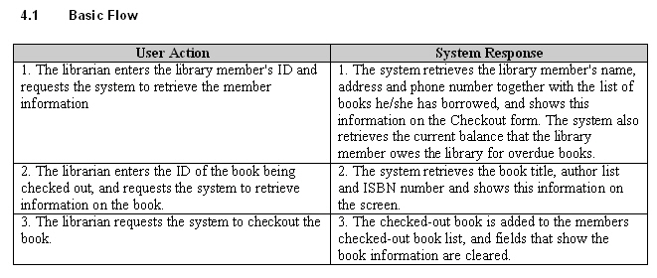
Use-Case Description Example (1/4)
Checkout Book
This use case allows the librarian to check-out books that library members want to borrow.
Actors
Librarian
Flow of Events

Slide 24
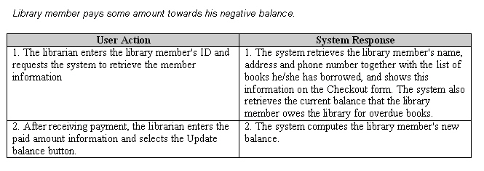
Use-Case Description Example (2/4)
Alternate Paths
Library Member Not Found
If the member id does not exist, the system displays a message that the member id cannot be found.
Book Not Found
If the book id does not exist, the system displays a message that the book id cannot be found.

Slide 25
Use-Case Description Example (3/4)
Pre-Conditions
Use is logged in to the system
Post-Conditions
New checkout record is added to the Library DB whenever checkout is successful.
Rules
Only members with a valid memberID can checkout books.
Only books that are found in the system an be checked out.
Students cannot checkout books if outstanding fines > $10.00.
Notes:
ID Course Overview
Note: rules give lots of clues to alternative paths.

Slide 26
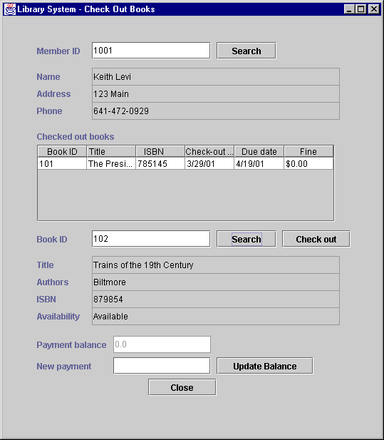
Use-Case Description Example (4/4)
Interface
Notes:
ID Course Overview
Having at least a mock interface available can make it much easier to visualize and elicit the use case, however, note caution about gui’s usually being designed after use cases are initially elicited—I.e., by HCI team.

Slide 27
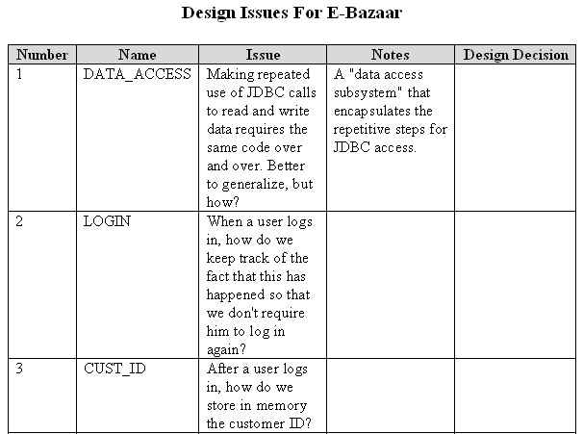
Recording Design Issues
As Use Case descriptions are being developed, questions will arise about how to design or implement aspects of the Use Case
These issues cannot be resolved completely during analysis, but should be recorded in a Design Issues document that grows over time.

Slide 28
Requirements Analysis Topics
A modern software requirements specification (SRS)
Use-Case Model
  Use cases drive entire development lifecycle
  Use case diagrams
  Use case descriptions
  Guidelines for developing use cases
    Business rules in use cases
    Structuring complex use cases
Supplementary Specs
Glossary
Review

Slide 29
Use Cases DO's
Use Cases should be named in a way that suggests the goal of the use case -- that is, the goal of the actor in its interaction with the system for this use case.
A Use Case should include a set of successful paths from a trigger event to the goal (success scenarios)
Should also record a set of paths from a trigger event that fall short of the goal (failure scenarios)
Evolve to more detail over the lifecycle

Slide 30
Use Cases DON'Ts
A Use Case should not specify user interface design
  Usually it is too early to commit to interface details
  Instead, the UI is typically designed on the basis of the requirements.
  However, Use Cases often offer suggestions about the look of the UI as an aid to understand the flows of the Use Case. These suggestions may be adopted, modified, or rejected completely when the UI is designed later on, but the principles they illustrate will survive in one form or another.
A Use Case should not attempt to specify implementation detail beyond any technical constraints that may have been imposed on the project.
J160-6

Slide 31
Recommended Steps for Creating Use Cases
Identify actors
Name use cases
  Start with verb, reflect goal
Brief description
Main success scenario
Pre and post conditions
Alternate flows
Exceptional flows—what might go wrong
Business rules
Associated non-functional requirements
Notes:
ID Course Overview
Exceptional flows--For each step in the use case, consider what can go wrong. Each unique exception can be captured as an Exception Flow. In some cases, a single Exceptions Flow will be used commonly across the use case, e.g. “Timeout”. The key information to be captured is what the business requirement is when the exception occurs, i.e. what should the actors experience be?

Slide 32
Requirements Analysis Topics
A modern software requirements specification (SRS)
Use-Case Model
  Use cases drive entire development lifecycle
  Use case diagrams
  Use case descriptions
  Guidelines for developing use cases
    Business rules in use cases
    Structuring complex use cases
Supplementary Specs
Glossary
Review

Slide 33
Structuring Complex Use Cases
Packages
Use case relationships

Slide 34
Organize Related Use Cases in Packages
Semantically related groups
Development groups
Delivery groups

Slide 35
Use Case Relationships
Decompose complex use cases
Include
  “.. relationships beyond .. includes .. strongly suggest you ignore them.” (Fowler, p102)
Extend
Generalize
Q32-34, F44-45
Notes:
ID Course Overview

Slide 36
Use Case Relationships: Include
Common steps used in several use cases
Subgoals/subflows
E.g., login, print, valuation
Analyze Risk
<<include>>
Trader
<<include>>
Valuation
Price Deal
F42-45
Notes:
ID Course Overview

Slide 37
Use Case Relationships: Extend
Variants on normal behavior that you want to represent as a separate use case
Alternative and exceptional flows
Buyer
Pay Invoice
Seller
<<extend>>
Pay Overdraft Fee
J150, J169
Notes:
ID Course Overview

Slide 38
Use Case Relationships: Generalize
“Abstract” use case that can be realized in different ways
Contains behavior that is common to different instantiations
E.g., purchase product or pay invoice: transactions
Perform Transaction
Buyer
Pay Invoice
Seller
<<extend>>
Pay Overdraft Fee
Notes:
ID Course Overview

Slide 39
Requirements Analysis Topics
A modern software requirements specification (SRS)
Use-Case Model
  Use cases drive entire development lifecycle
  Use case diagrams
  Use case descriptions
  Guidelines for developing use cases
    Business rules in use cases
    Structuring complex use cases
Supplementary Specs
Glossary
Review
Notes:
ID Course Overview

Slide 40
Nonfunctional Requirements
E.g., performance, security, user sophistication, hardware, software, …
Attach use-case specific ones to use cases
Others in supplementary specifications list
Notes:
ID Course Overview
use case relationships (fowler, p44-45)
– fig 3-2 fowler
– includes (formally “uses”)—use to avoid repetition of common set of steps
[9]
include: simple—just some common (subgoals) used in several use cases—e.g., print or valuation
* see subflows flows in rational examples
extend: for variants on normal behavior that you want to represent as a separate use case (vs just as a variation or alternative flow within a use case)
e.g., see alternative flows in rational examples
generalize: e.g., have an “abstract” use case that can be instantiated in different ways. The general use case contains behavior that is common to different instantiations—e.g., transactions→purchase product or pay invoice

Slide 41
Supplementary Specification
Functionality
Usability
Reliability
Performance
Supportability
Design constraints
Supplementary
Specification
Notes:
ID Course Overview

Slide 42
Supplementary Spec Example (1/2)
Objectives
The purpose of this document is to define non-functional requirements of the Library System. This Supplementary Specification lists the requirements that are not readily captured in the use cases of the use-case model. The Supplementary Specifications and the use-case model together capture a complete set of requirements on the system.
Scope
This Supplementary Specification applies to the Library System .
This specification defines the non-functional requirements of the system; such as reliability, usability, performance, and supportability as well as functional requirements that are common across a number of use cases. (The functional requirements are defined in the Use Case Specifications.).
Notes:
ID Course Overview

Slide 43
Supplementary Spec Example (2/2)
Reliability
The main system must be running 95% of the time.
Performance
The system shall support up to 15 simultaneous users against the central database at any given time.
Security
None
Design Constraints
The system shall integrate with an existing legacy system, the ECardCatalog Database, which is a MS Access database running on an Windows NT workstation.
Notes:
ID Course Overview

Slide 44
Requirements Analysis Topics
A modern software requirements specification (SRS)
Use-Case Model
  Use cases drive entire development lifecycle
  Use case diagrams
  Use case descriptions
  Guidelines for developing use cases
    Business rules in use cases
    Structuring complex use cases
Supplementary Specs
Glossary
Review
Notes:
ID Course Overview

Slide 45
Glossary
Problem domain terms
Facilitates common understanding among developers as well as domain experts
Glossary
J139-40
Notes:
ID Course Overview

Slide 46
Glossary Example (1/2)
1. Introduction
This document is used to define terminology specific to the problem domain, explaining terms, which may be unfamiliar to the reader of the use-case descriptions or other project documents. Often, this document can be used as an informal data dictionary, capturing data definitions so that use-case descriptions and other project documents can focus on what the system must do with the information.
2. Definitions
The glossary contains the working definitions for the key concepts in the Library System.
  2.1 ECardCatalog Database
The legacy database that contains all information regarding books in the library.
  2.2 Library Member
Person who checks-out books from the library.
Notes:
ID Course Overview

Slide 47
Glossary Example (2/2)
  2.3 Librarian
Person who works for the library and performs the check-in and check-out procedure. This person also manages library member information.
  2.4 Check-out Book
The procedure done if a library member wants to take a library book out of the library.
  2.5 Check-in Book
The procedure done if a library member returns a checked out book to the library.
  2.6 Overdue Fee
This is the amount that the library member has to pay the library when he/she returns a book later than the maximum allowed check-out days.
Notes:
ID Course Overview

Slide 48
Requirements Analysis Topics
A modern software requirements specification (SRS)
Use-Case Model
  Use cases drive entire development lifecycle
  Use case diagrams
  Use case descriptions
  Guidelines for developing use cases
    Business rules in use cases
    Structuring complex use cases
Supplementary Specs
Glossary
Review
Notes:
ID Course Overview

Slide 49
Review Questions
What are the main artifacts of requirements analysis, and what are their purposes?
What is a use case? List examples of use case properties (I.e., the parts of a UC description).
What is a scenario?
Name 3 elements of a UC diagram.
Notes:
ID Course Overview
Use Case Model, Supplementary Specs, Glossary
2. A use case is a collection of scenarios defined by goal of primary actor, showing how goal might succeed or fail
3. A scenario is a single path through a use case.
4. Actor, communication arrow, use case

